Slide 1

Islamic University of Technology
Course no: Phy 4143
Course Title: Physics II
Course Teacher : Dr Md. Sahab Uddin
Professor

Slide 2
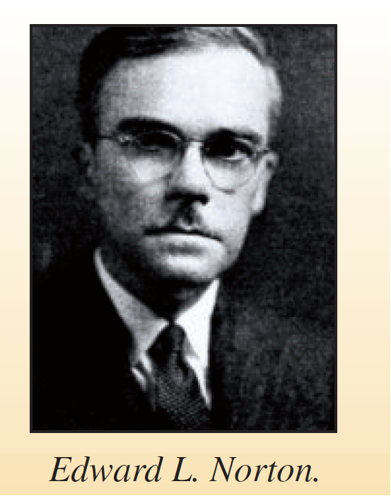
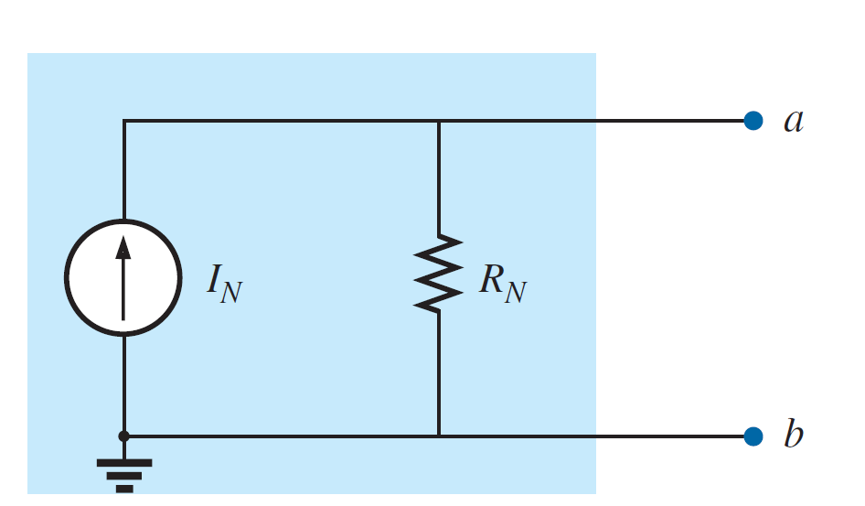
Norton’s Theorem
Norton’s theorem states that a linear two-terminal circuit can be replaced by an equivalent circuit consisting of a current source I_{N} in parallel with a resistor R_{N}, where I_{N} is the short-circuit current through the terminals and R_{N} is the input or equivalent resistance at the terminals when the independent sources are turned off.

Slide 3
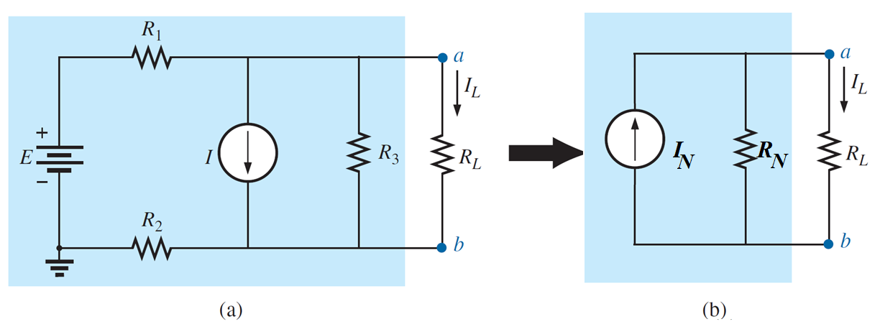
Norton’s Theorem

Slide 4
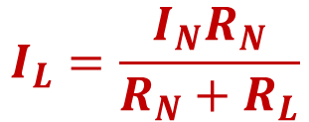
Norton’s Theorem
$$I_{L}=\frac{I_{N}R_{N}}{R_{N}+R_{L}}$$

Slide 5
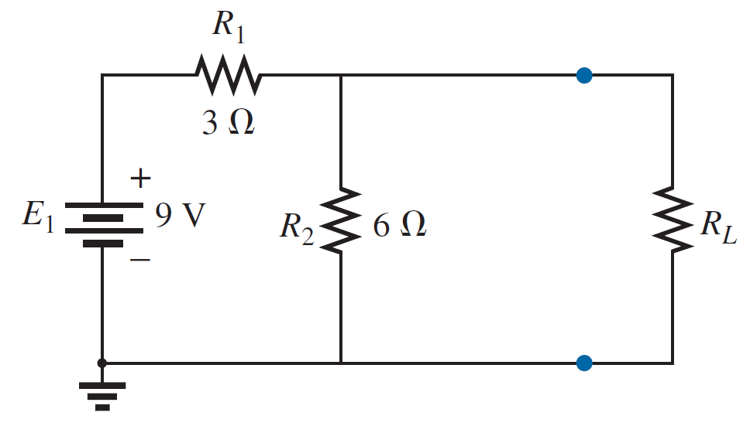

Norton’s Theorem
Norton’s Theorem Procedure
EXAMPLE 1: Find the Norton’s equivalent circuit. Then find the current through R_{L} for the circuit of figure.
$$R_{L}=10Ω$$

Slide 6

Norton’s Theorem
Norton’s Theorem Procedure
EXAMPLE 1: Find the Norton’s equivalent circuit. Then find the current through R_{L} for the circuit of figure.
Step 1:- Remove that portion of the network where the Norton’s equivalent circuit is found. In Figure below, this requires that the load resistor R_{L} be temporarily removed from the network.
$$R_{L}=10Ω$$

Slide 7
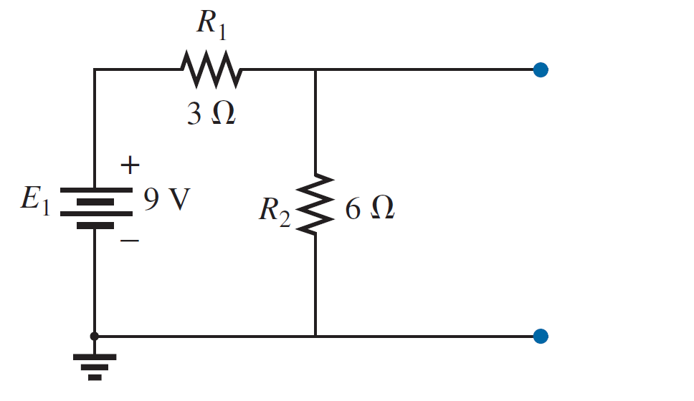
Norton’s Theorem
Norton’s Theorem Procedure
EXAMPLE 1: Find the Norton’s equivalent circuit. Then find the current through R_{L} for the circuit of figure.
Step 1:- Remove that portion of the network where the Norton’s equivalent circuit is found. In Figure below, this requires that the load resistor R_{L} be temporarily removed from the network.

Slide 8
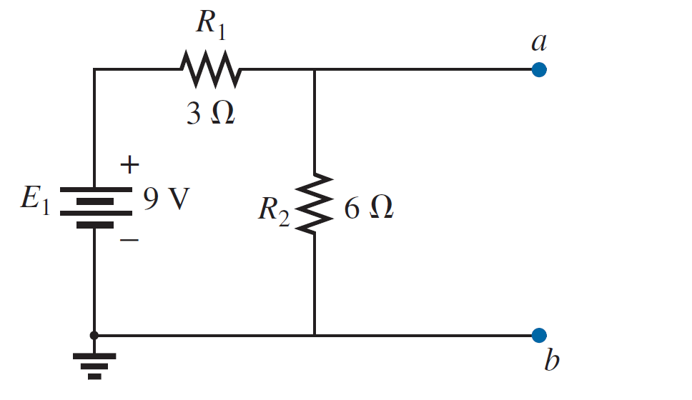
Norton’s Theorem
Norton’s Theorem Procedure
EXAMPLE 1: Find the Norton’s equivalent circuit. Then find the current through R_{L} for the circuit of figure.
Step 2:- Mark the terminals of the remaining two-terminal network. (The importance of this step will become obvious as we progress through some complex networks.)

Slide 9
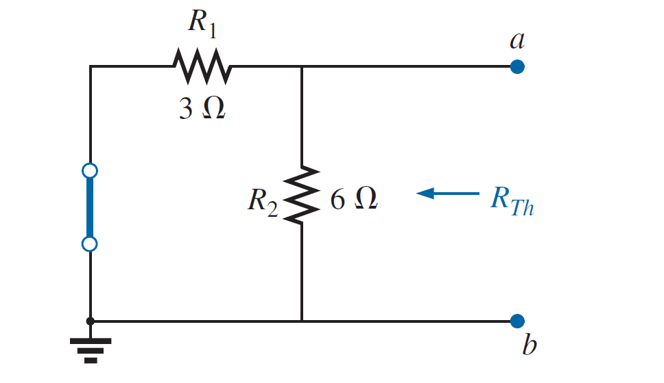
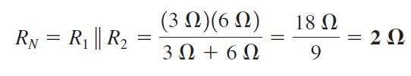
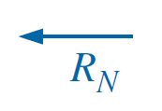
Norton’s Theorem
Norton’s Theorem Procedure
EXAMPLE 1: Find the Norton’s equivalent circuit. Then find the current through R_{L} for the circuit of figure.
Step 3:-Calculate R_{N} by first setting all sources to zero (voltage sources are replaced by short circuits, and current sources by open circuits) and then finding the resultant resistance between the two marked terminals.

Slide 10
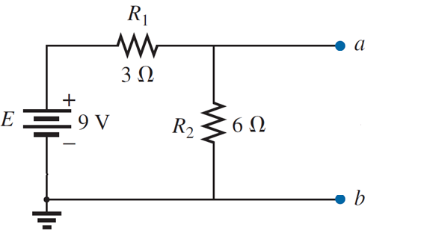
Norton’s Theorem
Norton’s Theorem Procedure
EXAMPLE 1: Find the Norton’s equivalent circuit. Then find the current through R_{L} for the circuit of figure.
Step 4:-Calculate I_{N} by first returning all sources to their original position and finding the short-circuit current between the marked terminals.

Slide 11
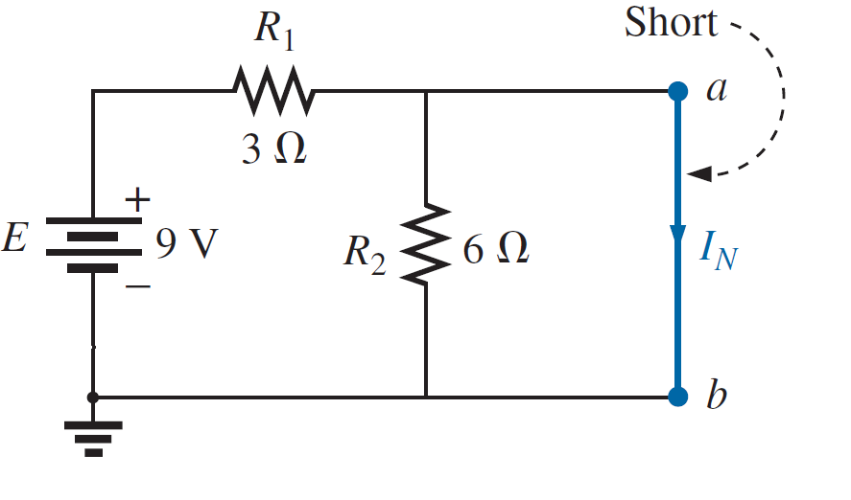
Norton’s Theorem
Norton’s Theorem Procedure
EXAMPLE 1: Find the Norton’s equivalent circuit. Then find the current through R_{L} for the circuit of figure.
Step 4:-Calculate I_{N} by first returning all sources to their original position and finding the short-circuit current between the marked terminals.

Slide 12

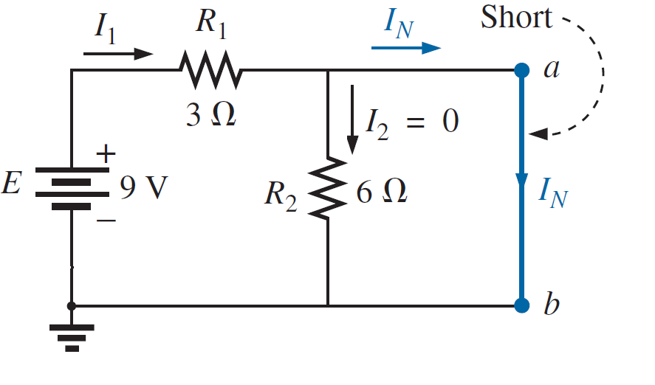
Norton’s Theorem
Norton’s Theorem Procedure
EXAMPLE 1: Find the Norton’s equivalent circuit. Then find the current through R_{L} for the circuit of figure.
Step 4:-Calculate I_{N} by first returning all sources to their original position and finding the short-circuit current between the marked terminals.

Slide 13
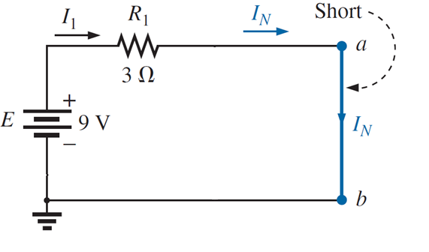

Norton’s Theorem
Norton’s Theorem Procedure
EXAMPLE 1: Find the Norton’s equivalent circuit. Then find the current through R_{L} for the circuit of figure.
Step 4:-Calculate I_{N} by first returning all sources to their original position and finding the short-circuit current between the marked terminals.

Slide 14
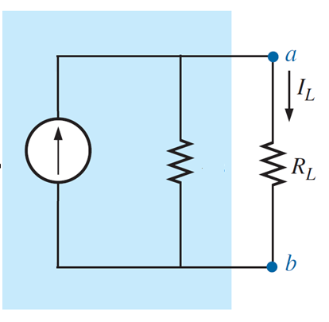

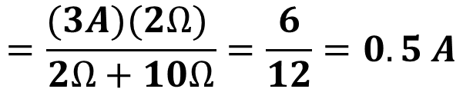
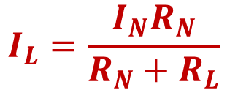


Norton’s Theorem
Norton’s Theorem Procedure
EXAMPLE 1: Find the Norton’s equivalent circuit. Then find the current through R_{L} for the circuit of figure.
Step 5:-Draw the Norton’s equivalent circuit with the portion of the circuit previously removed replaced between the terminals of the equivalent circuit.
$$I_{L}=\frac{I_{N}R_{N}}{R_{N}+R_{L}}$$
$$=\frac{(3A)(2Ω) }{2Ω+10Ω}=\frac{6}{12}=0.5 A$$
$$R_{N}=2Ω$$
$$I_{N}=3A$$
$$=10Ω$$

Slide 15
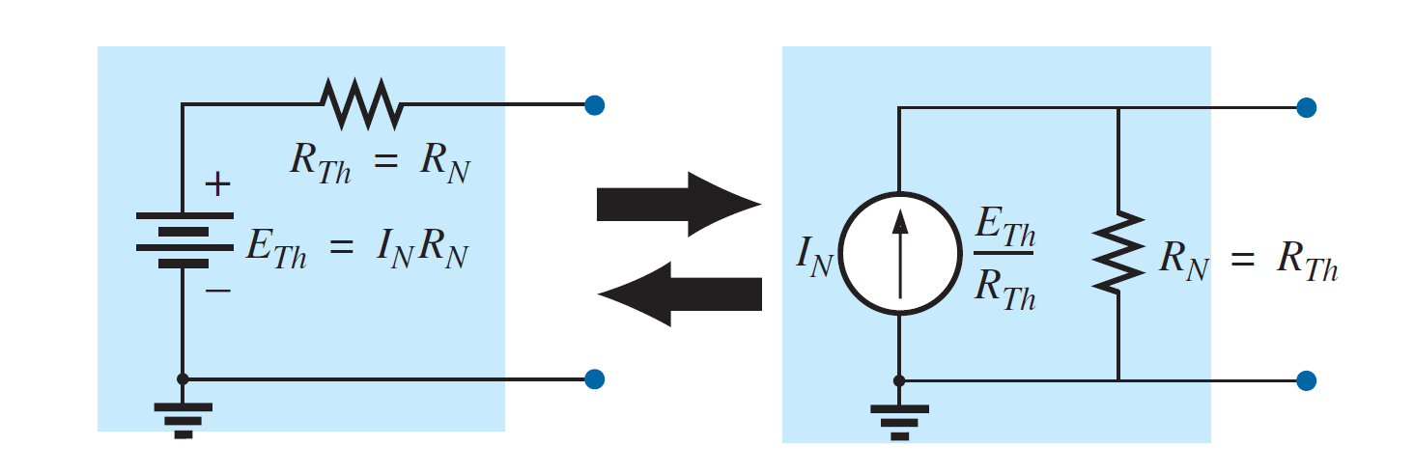
Norton’s Theorem
EXAMPLE 1: Find the Norton’s equivalent circuit. Then find the current through R_{L} for the circuit of figure.
Converting the Norton equivalent circuit to a Thévenin equivalent circuit.

Slide 16
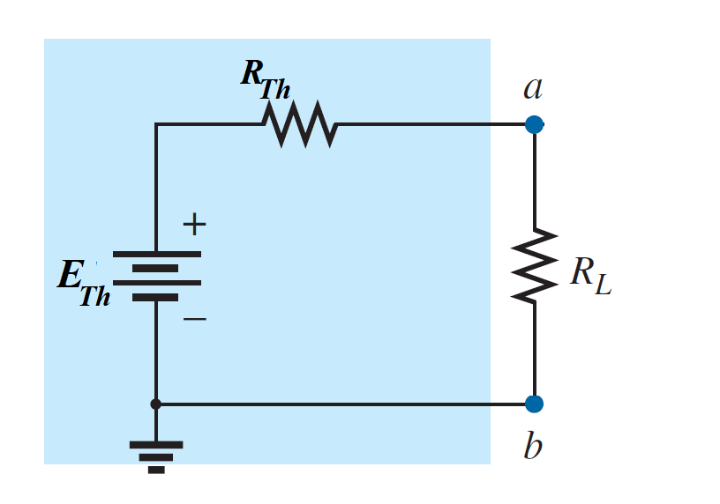







Norton’s Theorem
EXAMPLE 1: Find the Norton’s equivalent circuit. Then find the current through R_{L} for the circuit of figure.
Converting the Norton equivalent circuit to a Thévenin equivalent circuit.
$${=R}_{N}=2Ω$$
$$R_{N}=2Ω$$
$$I_{N}=3A$$
$$=10Ω$$
$$6 V$$
$$=10Ω$$
$$E_{Th}=I_{N}R_{N}=\left(3A\right)\left(2Ω\right)=6V$$

Slide 17
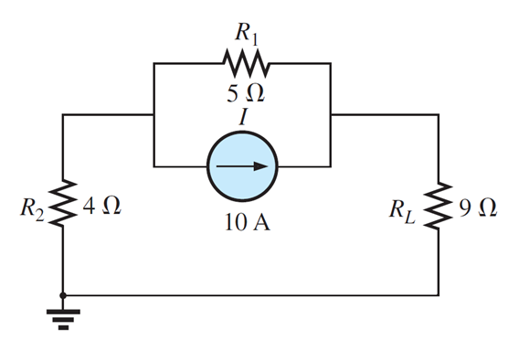
Norton’s Theorem
EXAMPLE 2: Find the Norton equivalent circuit for the network external to the 9 Ω resistor in Figure.

Slide 18
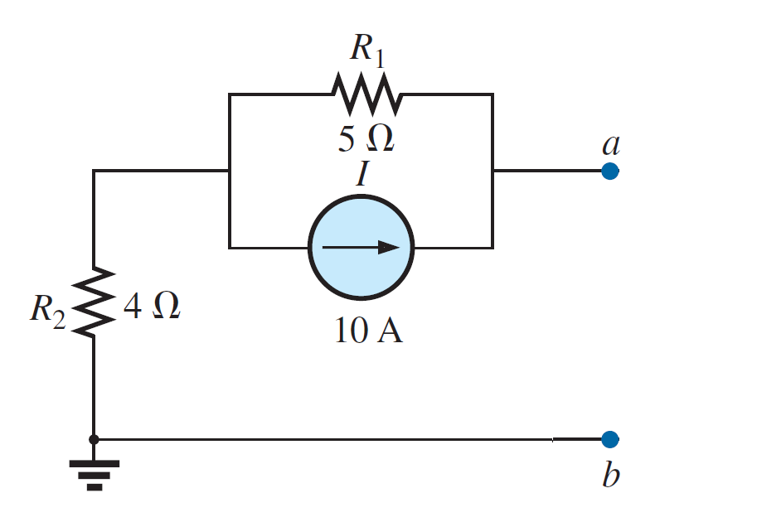
Norton’s Theorem
EXAMPLE 2: Find the Norton equivalent circuit for the network external to the 9 Ω resistor in Figure.
Solution:-
Step 1 and 2:-

Slide 19
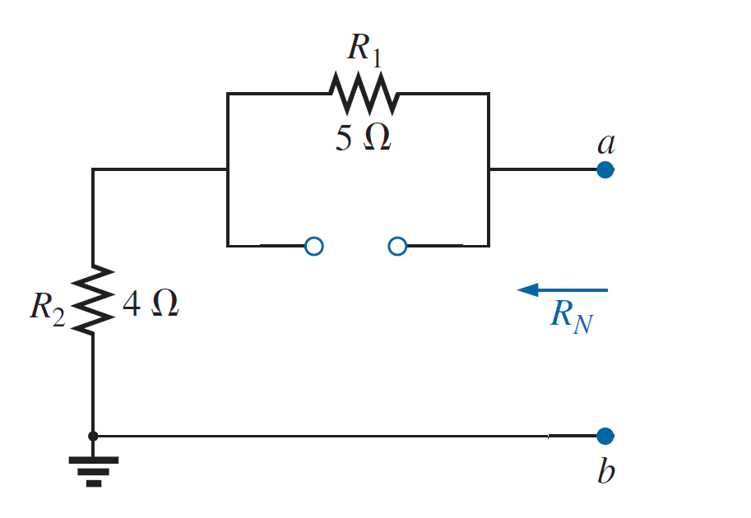

Norton’s Theorem
EXAMPLE 2: Find the Norton equivalent circuit for the network external to the 9 Ω resistor in Figure.
Solution:-
Step 3:-

Slide 20
Norton’s Theorem
EXAMPLE 2: Find the Norton equivalent circuit for the network external to the 9 Ω resistor in Figure.
Solution:-
Step 4:-

Slide 21
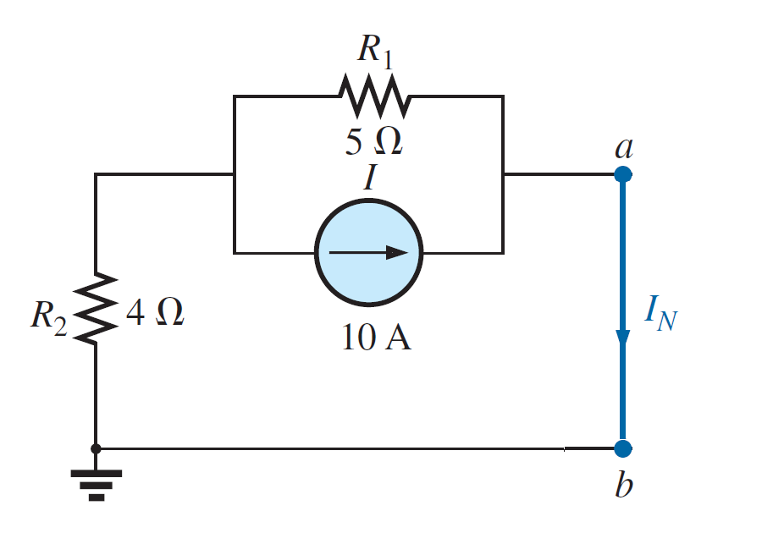
Norton’s Theorem
EXAMPLE 2: Find the Norton equivalent circuit for the network external to the 9 Ω resistor in Figure.
Solution:-
Step 4:-

Slide 22
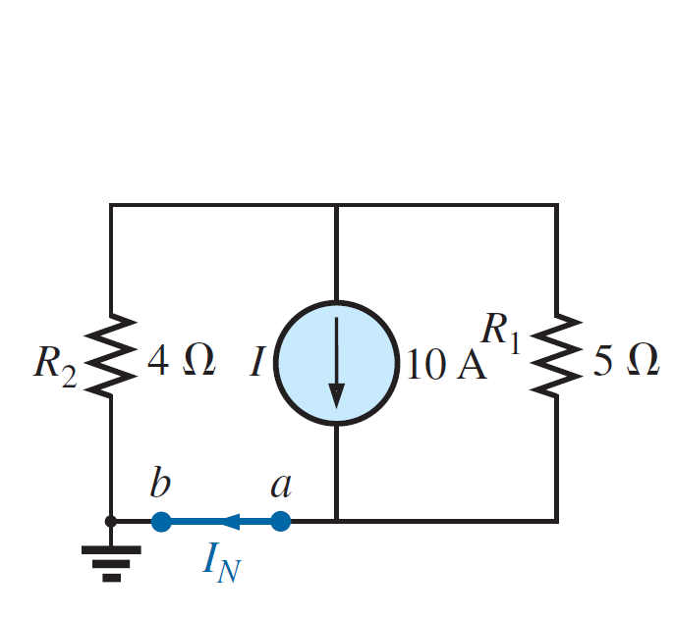

Norton’s Theorem
EXAMPLE 2: Find the Norton equivalent circuit for the network external to the 9 Ω resistor in Figure.
Solution:-
Step 4:-

Slide 23
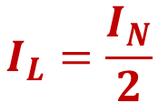

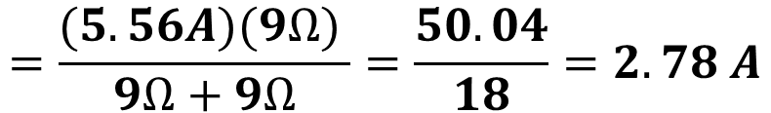


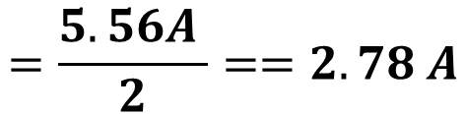
Norton’s Theorem
EXAMPLE 2: Find the Norton equivalent circuit for the network external to the 9 Ω resistor in Figure.
Solution:-
Step 5:-
$$I_{L}=\frac{I_{N}R_{N}}{R_{N}+R_{L}}$$
$$=\frac{(5.56A)(9Ω) }{9Ω+9Ω}=\frac{50.04}{18}=2.78 A$$
$$R_{N}=9Ω$$
$$I_{N}=5.56A$$
$$=9Ω$$
$$I_{L}=\frac{I_{N}}{2}$$
Or
$$=\frac{5.56A }{2}==2.78 A$$

